Slide 1

NLP CHATBOT DEVELOPMENT USING DIALOGFLOW
Supervisor Name: Abdullah Qamar
Department of Computer Science, Virtual University of Pakistan

Slide 2
Group ID: F2502F9228 (BC210414509)
Supervised By: Sir Abdullah Qamar
Student Name: Muhammad Arslan Akhtar
Student ID: BC210414509
Department of Computer Science, Virtual University of Pakistan

Slide 3

PROJECT OVERVIEW
This project is an Artificial Intelligence-based Conversational Agent designed for an educational institute.
It serves as a virtual receptionist, capable of handling student queries and performing registrations automatically.
Objective: To replace the manual inquiry process with an automated, 24/7 available system.

Slide 4
PROBLEM STATEMENT
Limited Availability
High Workload
Manual Data Entry
Administrative staff spends excessive time answering repetitive questions (Fees, Timings).
Paper-based registration leads to errors and data loss.
Need for Solution
An automated system was required to handle high volumes of queries instantly without human intervention.
Staff is only available during office hours (9 AM - 5 PM).

Slide 5
PROPOSED SOLUTION
NLP Chatbot
Platform
Functionality
Integrates Google Dialogflow (Frontend) with a Python Flask Server (Backend).
Understands natural English queries via NLP.
Fetches real-time course details from MySQL Database.
Validates user inputs (e.g., checking if a course exists).
Saves student registration data directly into the database.

Slide 6
KEY FUNCTIONALITIES
Course Info
Provides detailed information about available courses.
Schedule Info
Offers real-time updates on class schedules.
Active Courses
Lists courses that are currently available for enrollment.
Registration
Facilitates smooth registration for selected courses.
Certificate Status
Displays current status of course completion certificates.
Course Recommendation
Suggests relevant courses based on user input.

Slide 7
TECHNOLOGY STACK
Frontend / NLP Engine:
Backend Framework:
Database:
Tunneling Service:
IDE:
Google Dialogflow ES.
Python (Flask).
MySQL (XAMPP Server).
Ngrok (To expose local server to cloud).
Visual Studio Code.

Slide 8
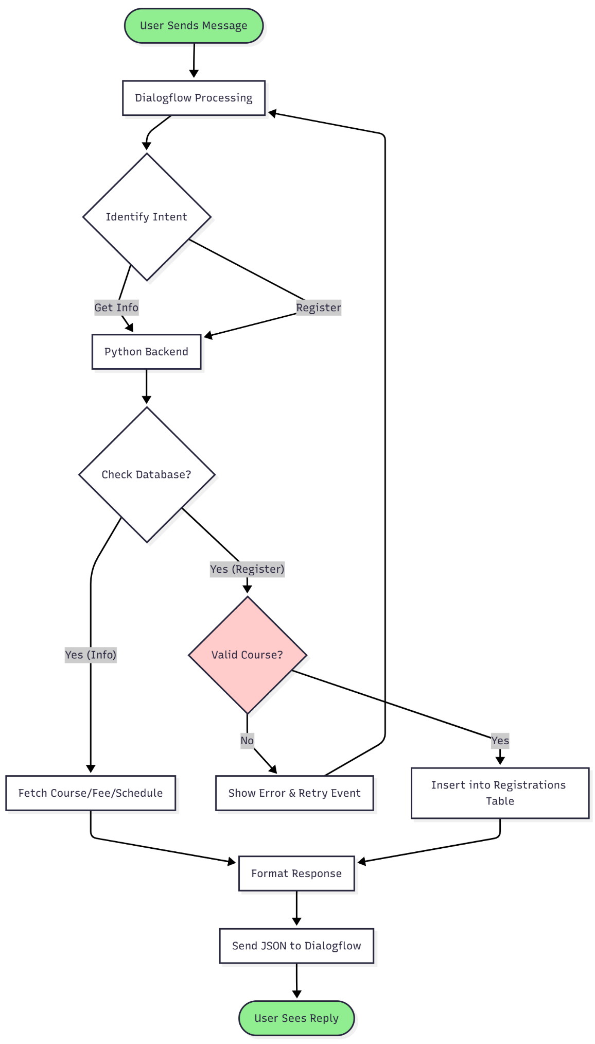
SYSTEM ARCHITECTURE (Flow Diagram)
Data Flow
Student types a query.
Intent Matching
Dialogflow identifies the user's intent.
Webhook Call
JSON request sent to Python Backend.
Database Operation
Python executes SQL (SELECT/INSERT).
Response
Data is formatted and sent back to the user.
User Input

Slide 9
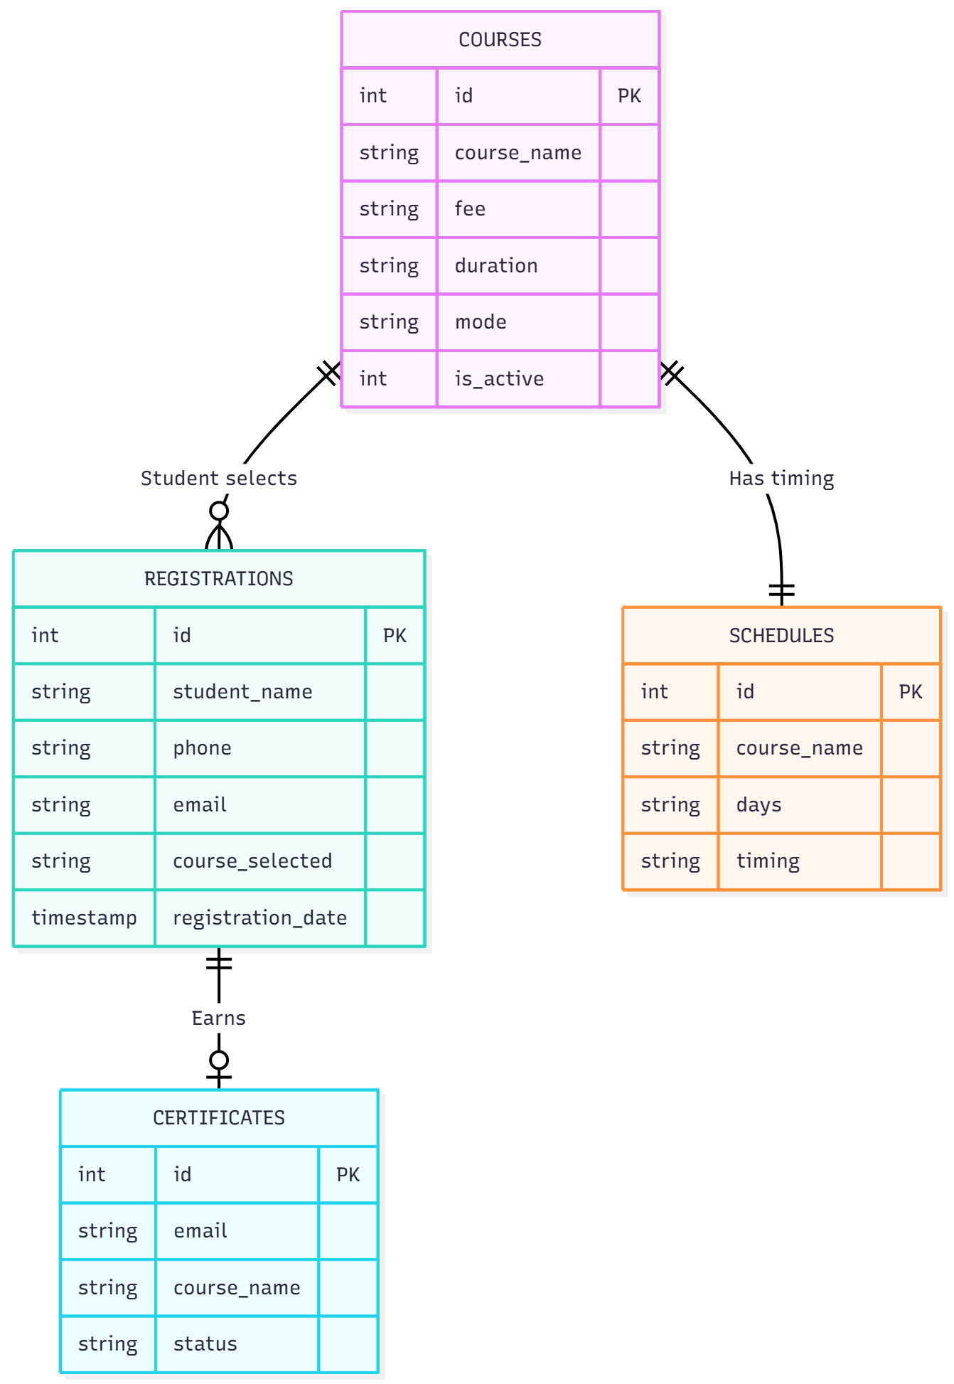
DATABASE DESIGN (ERD)
Database Schema
courses Table
registrations Table
schedules Table
Stores static info (Fee, Duration, Mode).
Stores dynamic student data
Stores class days and timings.
certificates Table
Stores completion status.

Slide 10
KEY TECHNICAL FEATURES
1. Connection Pooling:
2. Context Management (Correction Logic):
3. Security Implementation:
Implemented mysql.connector.pooling to manage multiple database connections efficiently, ensuring low latency.
Developed a logic to intercept wrong course names during registration.
The system prompts the user to "Retry" and validates the new input without restarting the conversation.
Used Parameterized SQL Queries (%s) to prevent SQL Injection attacks and ensure data security.

Slide 11
TESTING & RESULTS (Interface)
User Interface:
The chatbot uses Rich Content (Chips & Cards) for a better user experience.

Slide 12
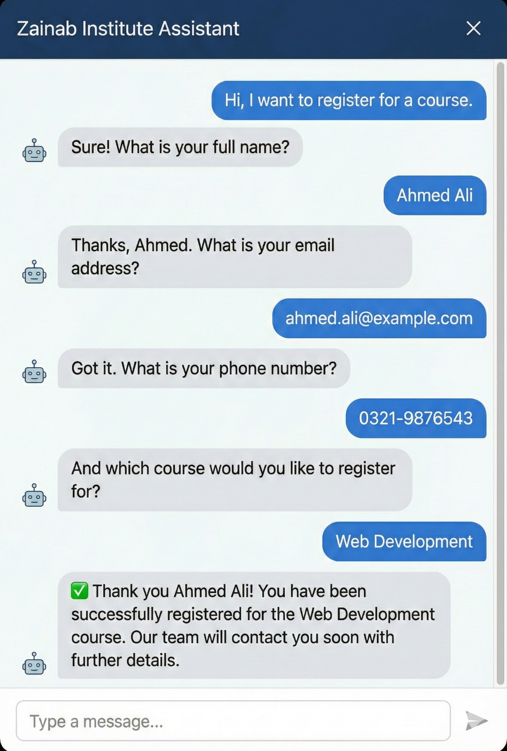

TESTING & RESULTS (Registration)
Registration Module:
Validation:
Completion:
The system successfully collects Name, Email, Phone, and Course.
It verifies the course name against the database before confirming
Data is permanently stored in the MySQL registrations table.
.

Slide 13
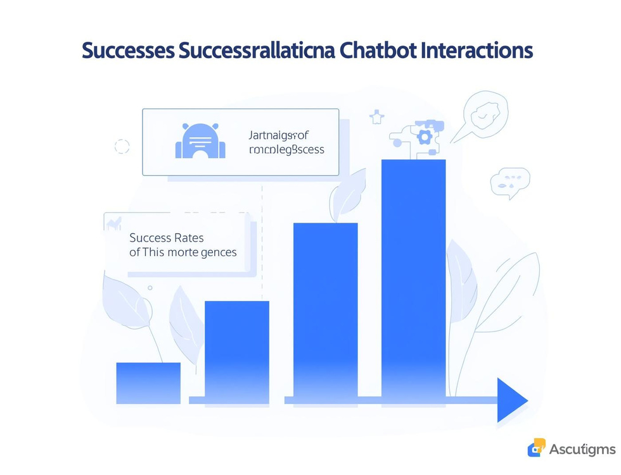


Results & Testing
Success Rates
Response Times
User Experience
The chatbot successfully handled all intents triggered during testing sessions as expected.
All database queries were executed in under one second, ensuring quick user responses.
Users reported a smooth experience with small talk and general inquiries effectively handled.

Slide 14
CONCLUSION & FUTURE SCOPE
Conclusion:
The project successfully automates the inquiry and registration process.
It reduces administrative workload and provides instant 24/7 support to students.
Future Enhancements:
Urdu Language Support: Integrating Roman Urdu for broader accessibility.
Payment Gateway: Adding JazzCash/EasyPaisa API for online fee submission.

Slide 15
REFERENCES
Google Cloud. (2024). Dialogflow ES Documentation. Retrieved from https://cloud.google.com/dialogflow/docs
Flask Web Framework Documentation.
MySQL Connector/Python Developer Guide.

Slide 16

Thank You

